Slide 1
Solar Siting
Stakeholder Meeting #1
March 29, 2022

Slide 2
Welcome
This is the second public stakeholder meeting for
Docket # QO21101186
Competitive Solar Incentive (“CSI”) Program
pursuant to P.L. 2021, c.169
This meeting will focus on the Solar Siting Straw Proposal released on March 16, 2022.

Slide 3
Webinar Instruction Page
All attendees will be automatically muted
Questions? Please use the “Q & A” function in Zoom
Please note that the “Chat” function in Zoom is not available for this meeting
This meeting is being recorded. By attending and participating in this meeting, you acknowledge and consent to being recorded.
A copy of the recording and slides will be made available on the New Jersey Board of Public Utilities (“NJBPU”) website:
https://www.nj.gov/bpu/newsroom/public/

Slide 4
Disclaimer
This presentation is provided for informational purposes only and should not be taken to represent the views of the NJBPU, its Commissioners, or the State of New Jersey.
Please be aware that any information presented is subject to change if there are changes to New Jersey statutes, rules, or policies.
All viewers are responsible for ensuring that they rely only on current legal authority regarding the matters covered in the presentation.

Slide 5
Agenda
Background review
Discussion of today’s focus areas:
  Applicability of siting criteria
  Four categories of siting
  Identification of farmland subject to caps
  Implementation of farmland caps
  Waiver process
Stakeholder Comment Guidelines
Stakeholder Comment Session

Slide 6
Poll: Participants
Notes:
Poll:
Please indicate your affiliation
Solar Developer
Other Solar Industry Representative
NGO
Government
Other: (please specify)

Slide 7
Solar Program Background
Solar Act of 2021 and SuSI Program
• The Solar Act of 2021, P.L. 2021, c.169 (“Solar Act”), signed by
Governor Murphy on July 9, 2021, directs the NJBPU to establish
a comprehensive program to provide incentives for the
development of at least 3,750 megawatts (“MW”) of new solar
power generation by 2026.
• The Board took a significant step in implementing the Solar Act by
establishing the Successor Solar Incentive (“SuSI”) Program on
July 28, 2021.

Slide 8
The SuSI Program – Part 1
The SuSI program, pursuant to the Solar Act, consists of two parts:
Part 1
The Small Solar Facilities program, covering the Administratively Determined Incentive (“ADI”) program
  All net metered residential solar installations
  Net metered commercial solar installations of 5 MWdc or smaller
  A temporary program for grid supply solar installations previously covered under “Subsection (t)”
  The Community Solar program
    Note: Design of the permanent Community Solar program is subject of another proceeding
  The ADI program has been in operation since August 28, 2021

Slide 9
The SuSI Program – Part 2
Part 2
The Competitive Solar Incentive (“CSI”) program, covering
  All grid supply solar installations
  Net metered commercial solar installations greater than 5 MWdc
  The CSI Program is under design, with a Straw Proposal release and further stakeholder proceedings expected soon

Slide 10
Siting Background
The Solar Act specifies siting criteria for all grid supply solar facilities and net metered solar facilities greater than five megawatts. (N.J. Stat. § 48:3-119 (2021))
As the Solar Act directs, NJBPU Staff has consulted with the New Jersey Department of Environmental Protection (“DEP”), the New Jersey Department of Agriculture, and the
State Agriculture Development Committee (“SADC”) to develop recommendations for implementing the statute.

Slide 11
Applicability of Siting Criteria
Siting criteria to apply to all grid supply projects, as well as net metered non-residential projects greater than 5 MWdc that intend to connect to the electric grid in NJ.
All projects would be required to register under the CSI program. Projects not seeking an incentive would have to register with a $0 bid.

Slide 12
Siting Categories
The Solar Act recognizes 4 categories of solar siting:
Siting where solar is prohibited outright
Siting where solar requires a waiver from the Board
Siting subject to caps
Unrestricted siting
Note that all siting not explicitly covered under categories1-3 automatically falls under category 4, and is therefore not subject to siting restrictions as proposed for the purposes of this program. Local permitting and other restrictions still apply.

Slide 13
Category 1: Outright Prohibition
Preserved farmland, except allowed under N.J.S.A. 4:1C-32.4 et seq.
Projects that would exceed five percent of unpreserved land containing prime agricultural soils and soils of Statewide importance located within any county’s Agricultural Development Area (“ADA”)
  See Category 3

Slide 14
Category 2: Siting requiring a waiver
Land preserved under the Green Acres Program
Land located within the preservation area of the pinelands area
Land designated as forest area in the pinelands comprehensive management plan
Land located within the Highlands preservation area
Land designated as freshwater wetlands or coastal wetlands
Forested lands
Projects that would exceed two and a half percent of NJ land containing prime agricultural soils and soils of Statewide importance located within any ADA
  See Category 3

Slide 15
Category 3: Siting subject to Caps
Farmland located in any ADA on prime soils and soils of Statewide importance
Subject to:
2.5% Statewide Threshold, above which a waiver is required
Per county 5% County Concentration limit, counting only unpreserved land, above which solar construction is prohibited

Slide 16
Category 4: Unrestricted siting
All land not explicitly covered under categories 1-3
Examples:
  All land not in the areas requiring a waiver, with a Land Use / Land Cover (“LULC”) classification in the DEP modified Anderson Classification system other than
    Agricultural lands: 2000 series
    Forested lands: 4000 series
    Wetlands: 6000 series
  Agricultural land outside ADAs

Slide 17
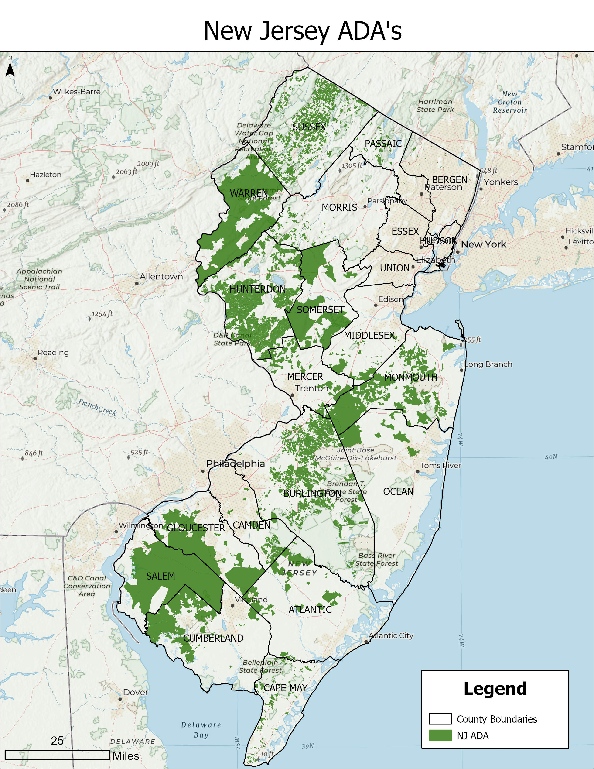
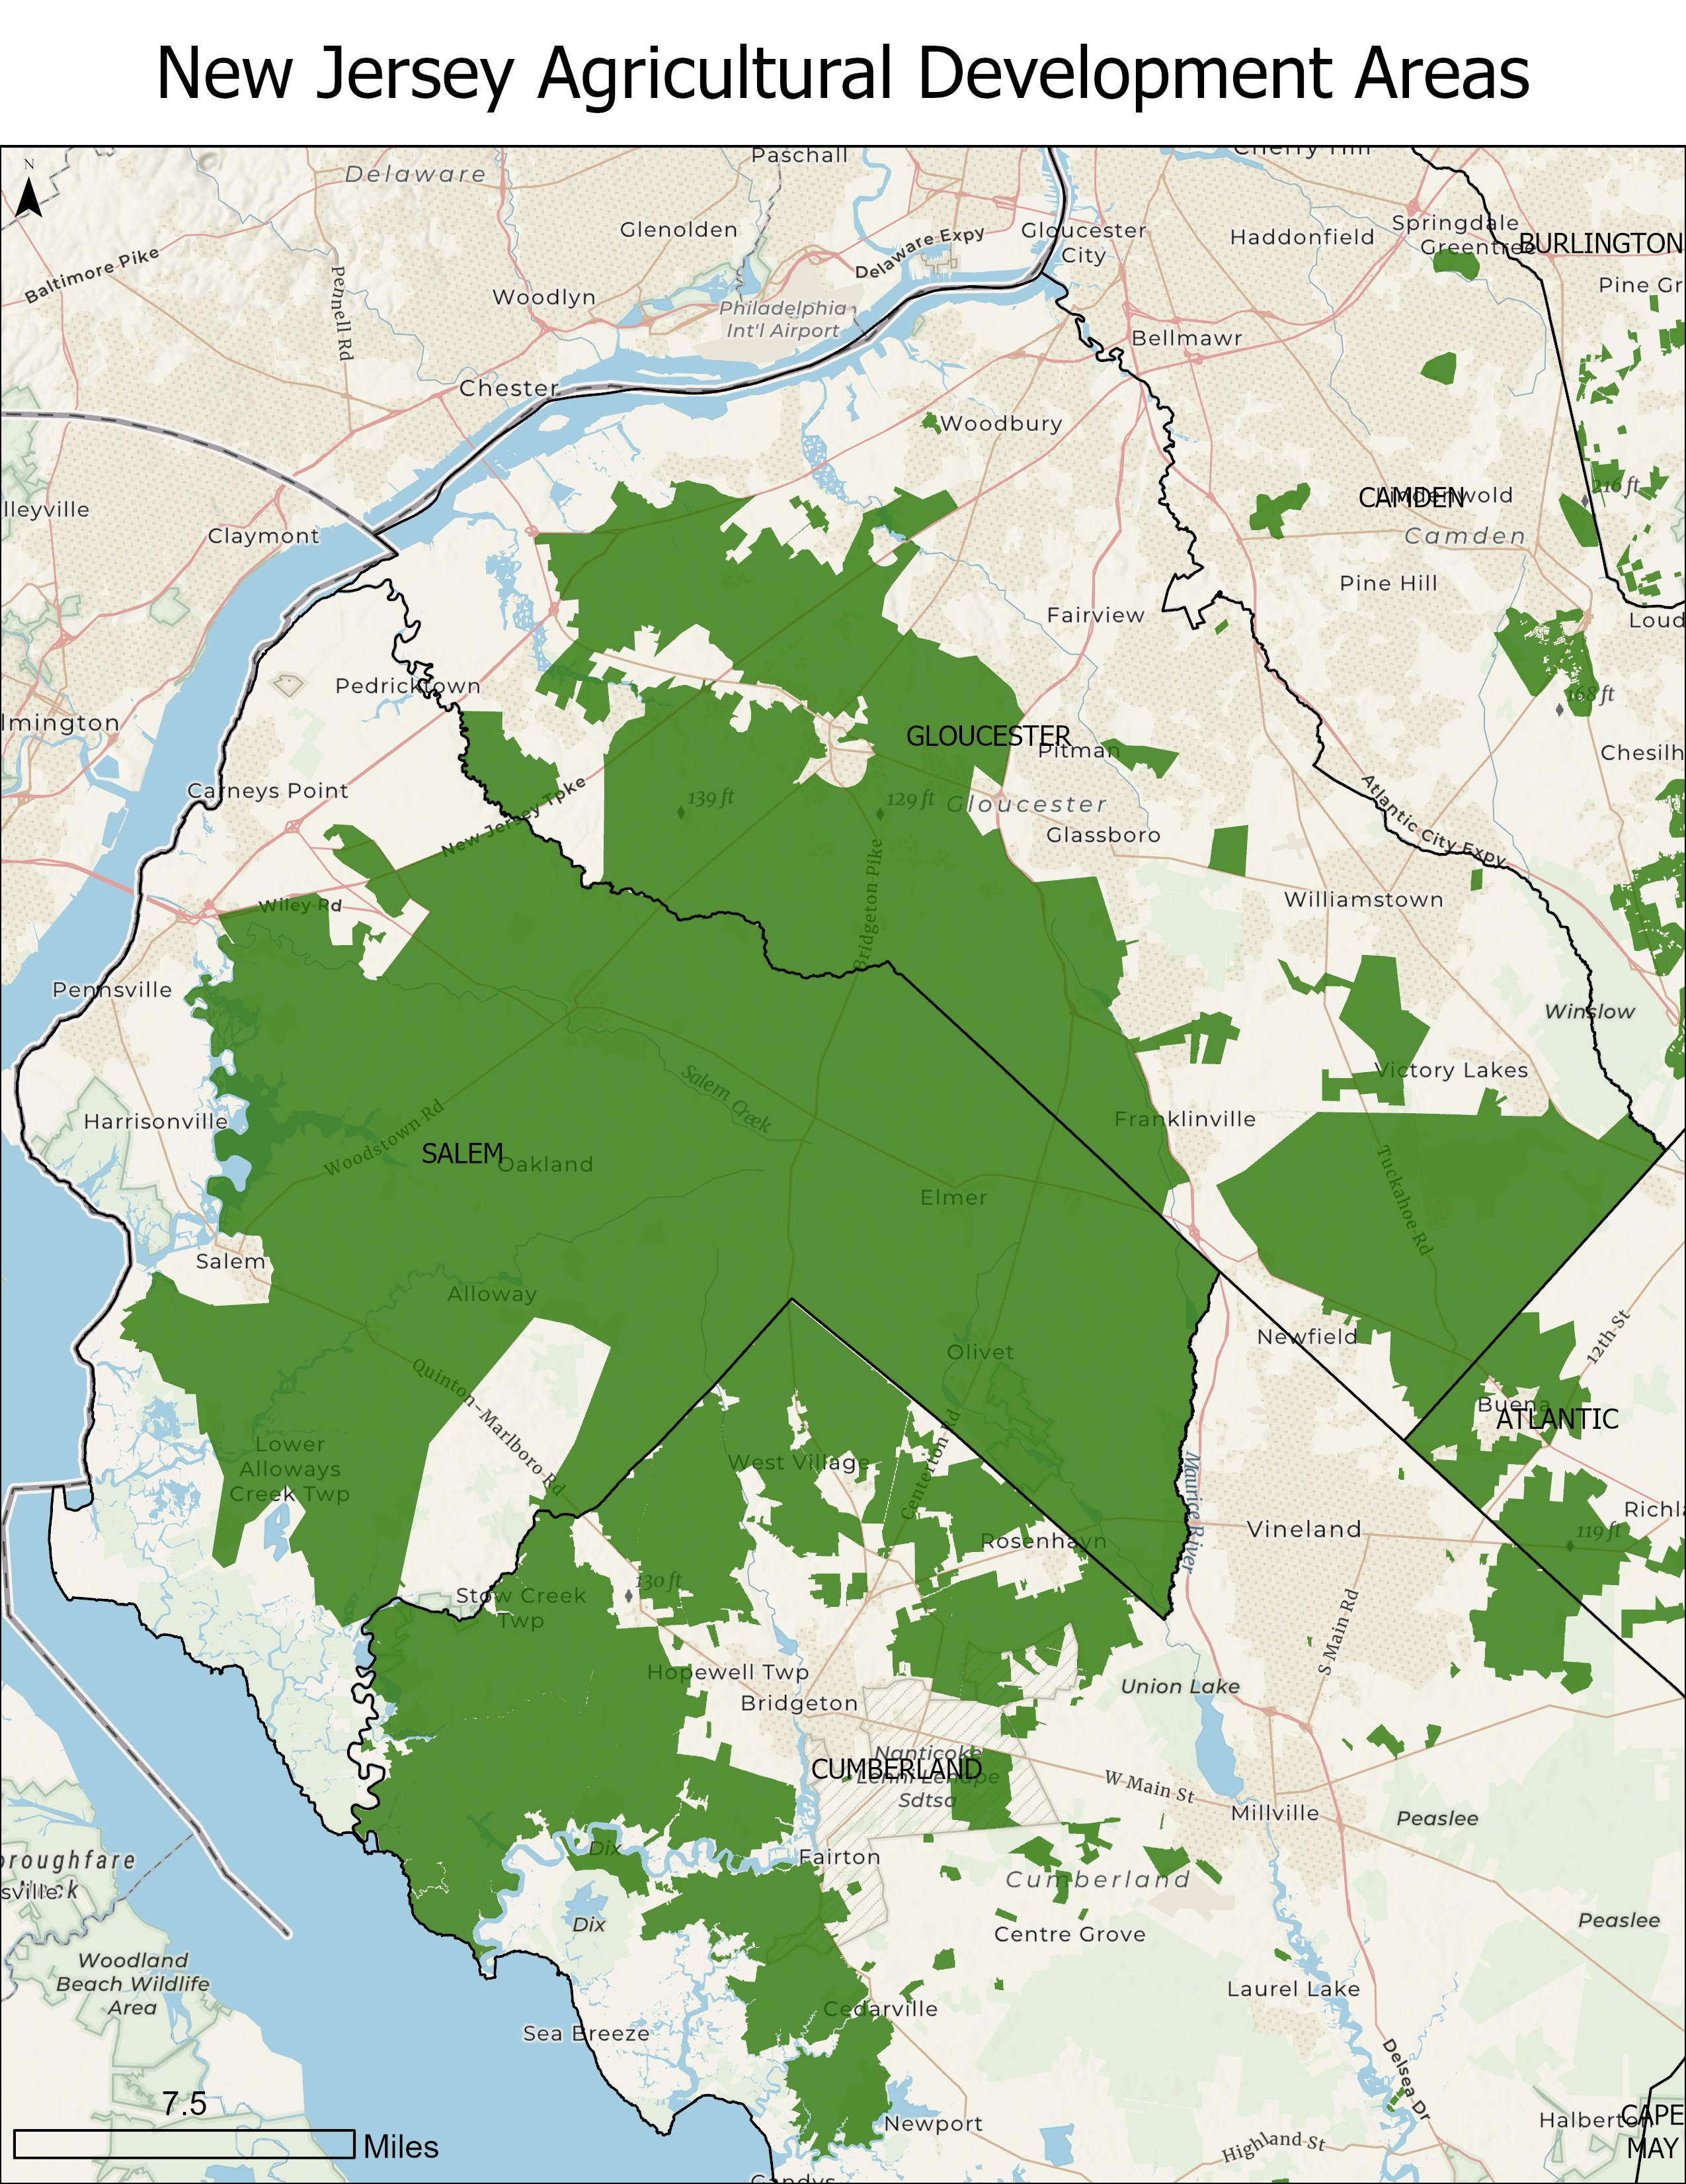
Example of determining land subject to caps

Slide 18
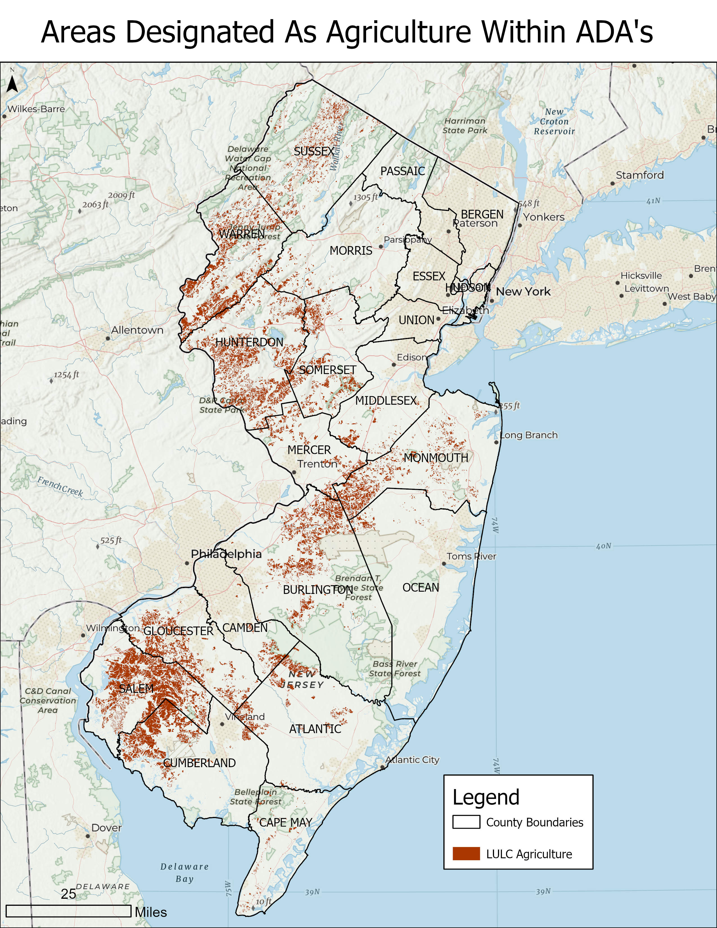
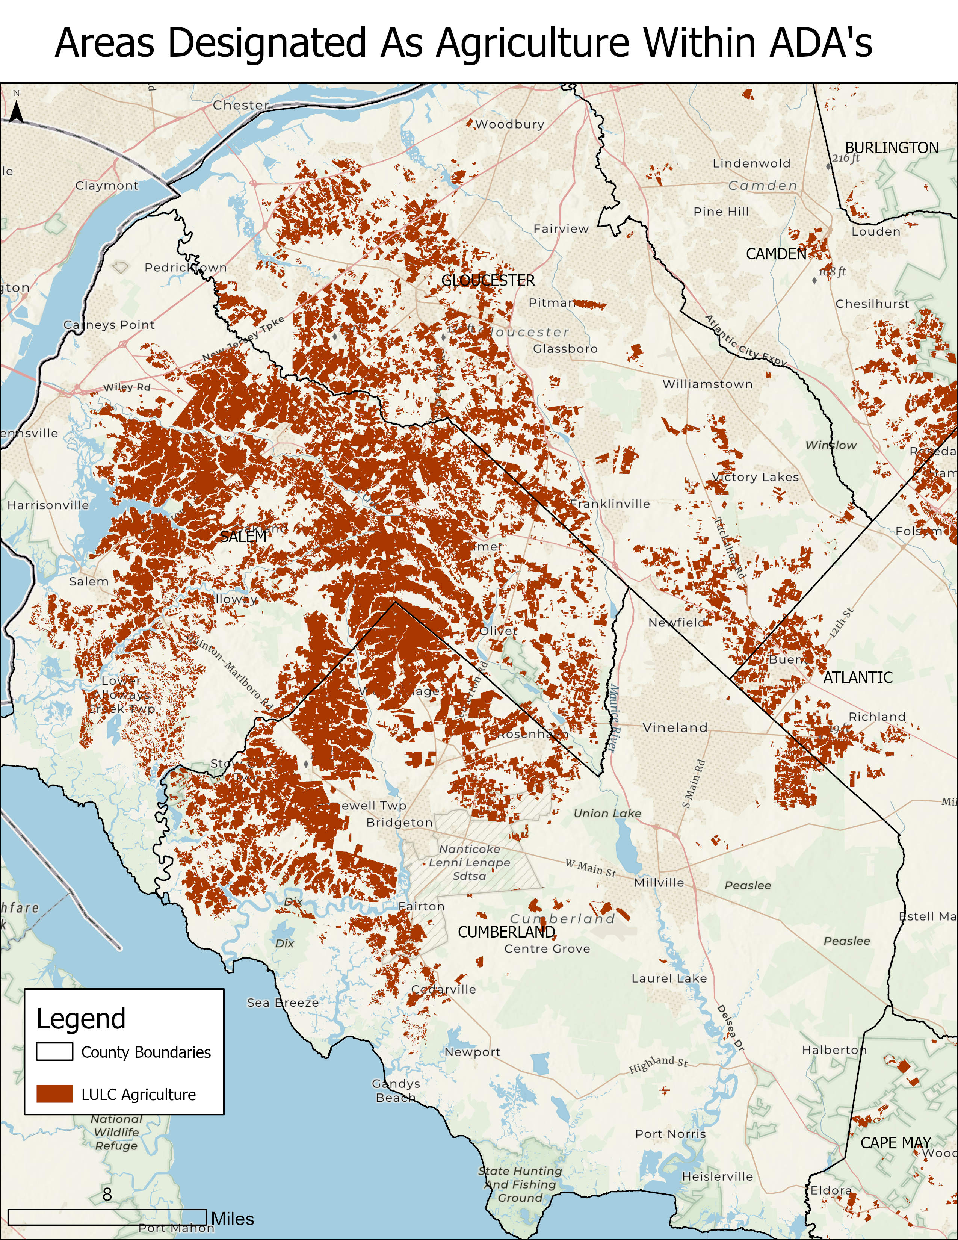
Example of determining land subject to caps

Slide 19
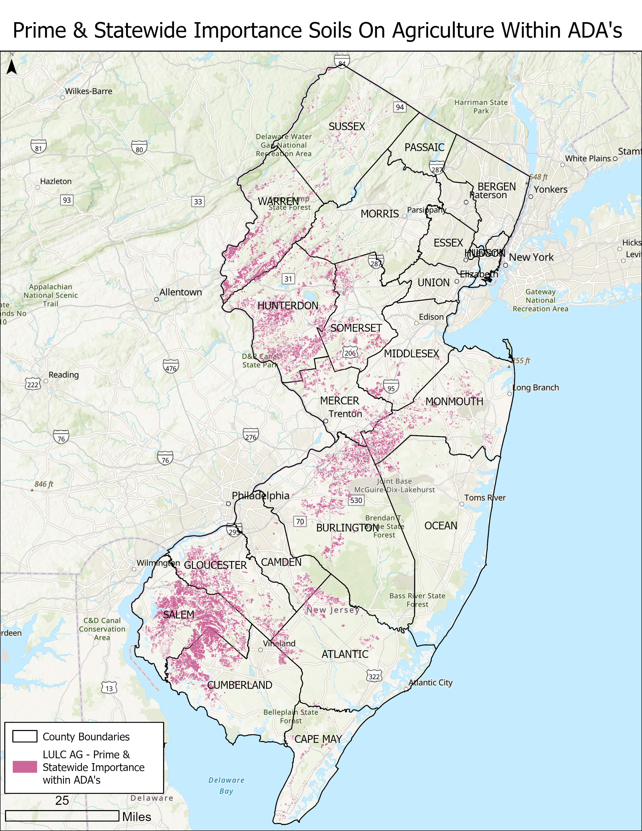
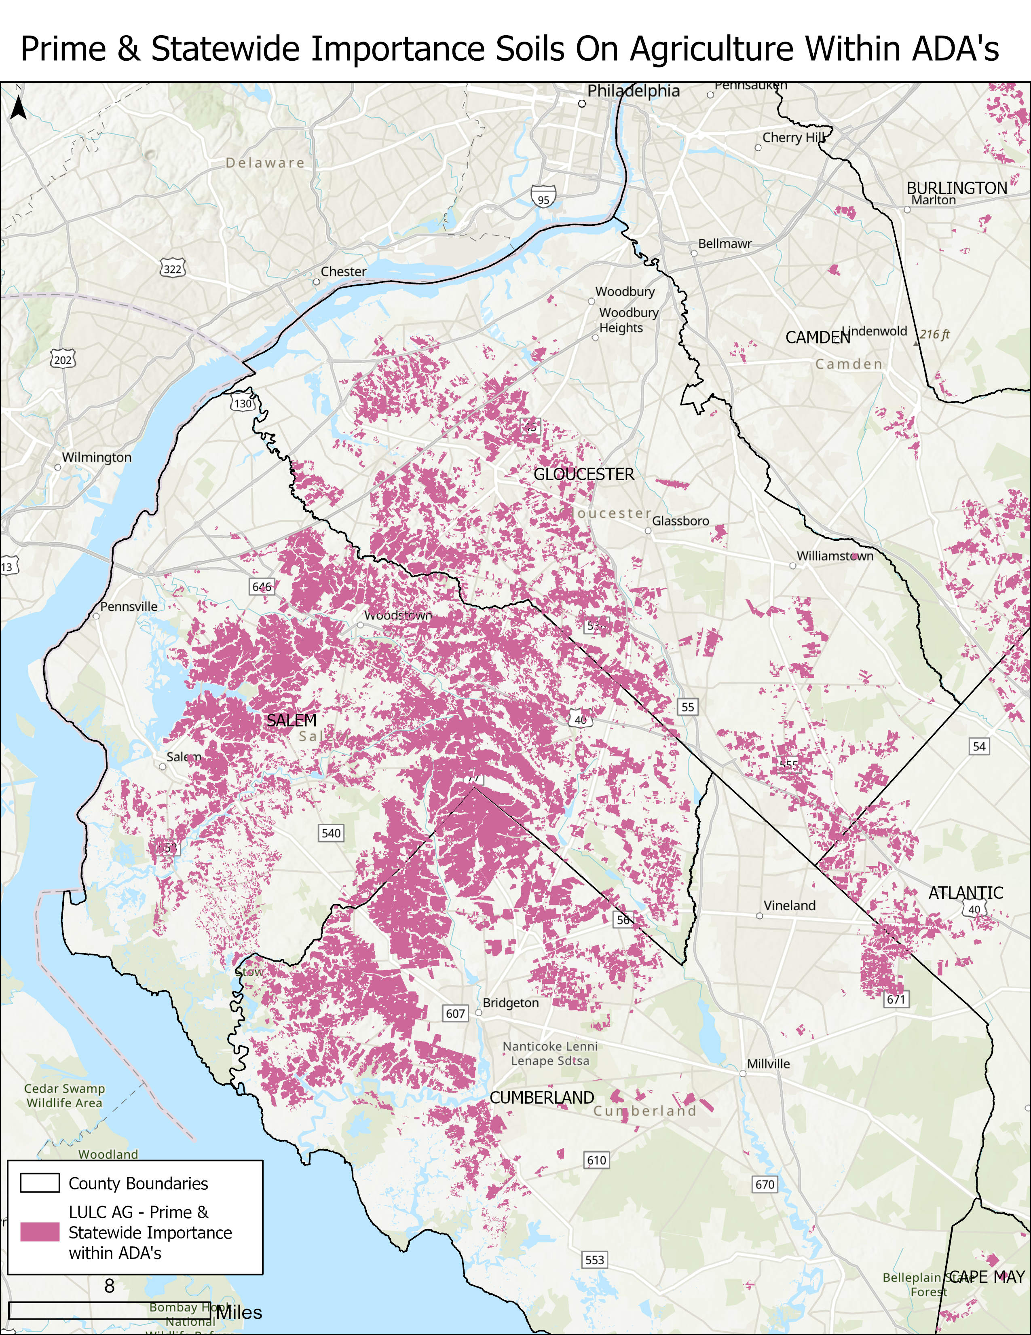
Example of determining land subject to caps

Slide 20
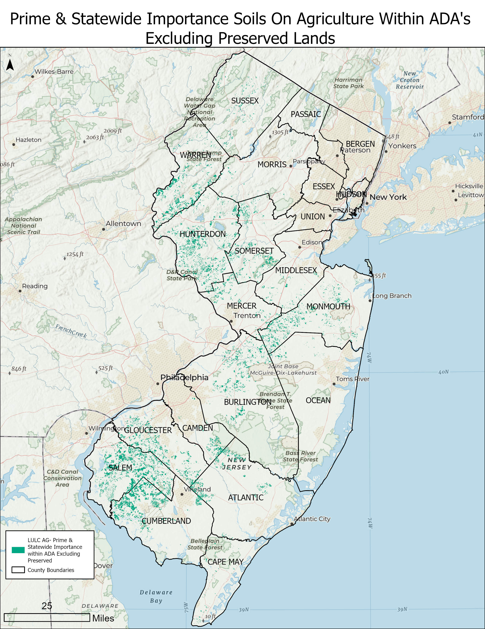
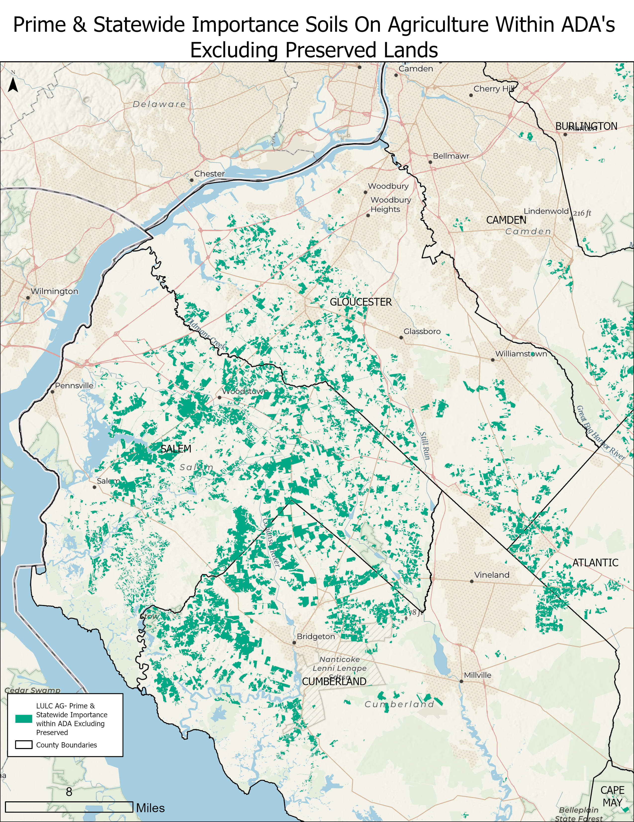
Example of determining land subject to caps

Slide 21
Implementation of Farmland Caps
Pursuant to the Solar Act, like projects in the CSI program will be ranked, and the highest ranked project(s) will receive award(s) under the program.
If a project would breach either the Statewide Threshold without having obtained a waiver, or any County Concentration Limit, it will not receive an award. Instead, the next project in line that would not breach any threshold will be awarded.
If a project does not begin construction before the registration deadline, the allocated farmland will be returned to the pool available for subsequent solicitations.

Slide 22
Poll: clarity of farmland guidance
Notes:
Poll:
Please indicate on a scale of 1-5, how you feel about the clarity of the proposed guidance around farmland
Totally unclear
Mostly unclear
Partially clear
Mostly clear
Totally clear

Slide 23
Waiver process
Projects that would fall in whole or in part on “Category 2” sites, will require a waiver from the NJBPU.
Where a “Category 2” site simultaneously has another LULC designation, by itself not subject to a waiver, the waiver requirement still applies (e.g., rooftop project where the building is in a “Category 2” location).​
The NJBPU will consult with the appropriate land use agency in reviewing the waiver request.
Projects proposed on the built environment in otherwise “Category 2” sites, to be subject to an expedited waiver process.

Slide 24
Construction requirements
The Straw Proposal includes a proposal, developed by the
Department of Ag. and the SADC, for construction requirements to be applied to solar on “Category 3” farmland. ​
The requirements will be subject of a specific stakeholder meeting on April 8, which NJBPU Staff will co-host with the Department of Ag and the SADC.​

Slide 25
Commenting ground rules
Please state your name and organization
Please limit your comments to the specific matter at hand: general siting
Remain respectful of other commenters
Please limit your comments to approximately 5 minutes
At 3:00 pm, we will take a 15 min break

Slide 26
Stakeholder comments

Slide 27
Break
The meeting will resume at 3:15 PM

Slide 28
Stakeholder comments

Slide 29
Written Stakeholder Comment Guidelines
The deadline for comments on the Siting Straw is 5:00 p.m. ET on Friday, April 22, 2022
Please submit comments directly to Docket No. QO21101186, using the “Post Comments” button on the NJBPU’s Public Document Search tool.
Comments are considered “public documents” for purposes of the State’s Open Public Records Act and any confidential information should be submitted in accordance with the procedures set forth in N.J.A.C. 14:1-12.3.
Written comments may also be submitted to:
    Secretary of the Board
    44 South Clinton Avenue, 1st Floor
    Post Office Box 350
    Trenton, NJ 08625-0350
    Phone: 609-292-1599
    Email: board.secretary@bpu.nj.gov

Slide 30
THANK YOU – Let’s continue the conversation veronique.oomen@bpu.nj.gov

